Slide 1
Electronic Transparencies for Introduction to Learning and Behavior 5e
By Russell A. Powell, P. Lynne Honey, and Diane G. Symbaluk

Slide 2
Chapter 1

Slide 3
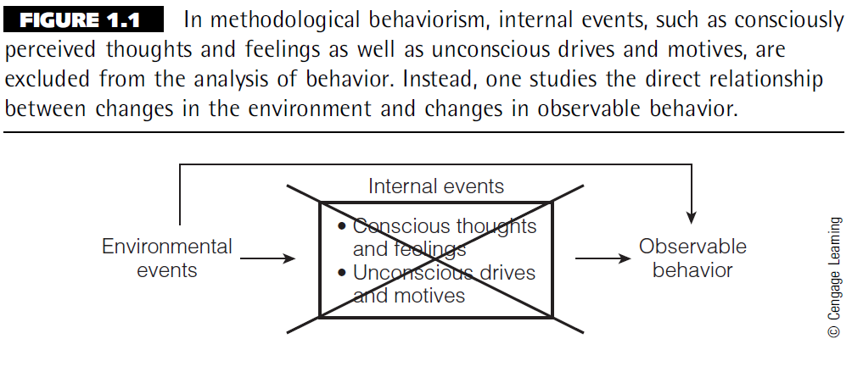
Figure 1.1

Slide 4
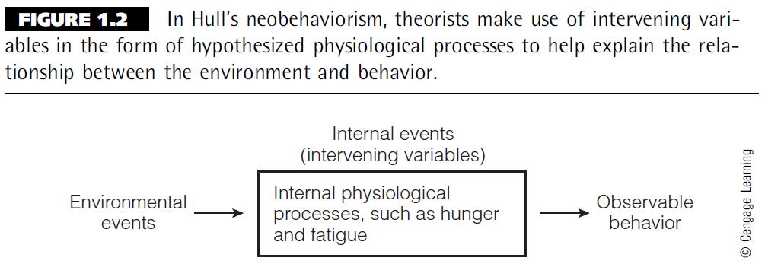
Figure 1.2

Slide 5
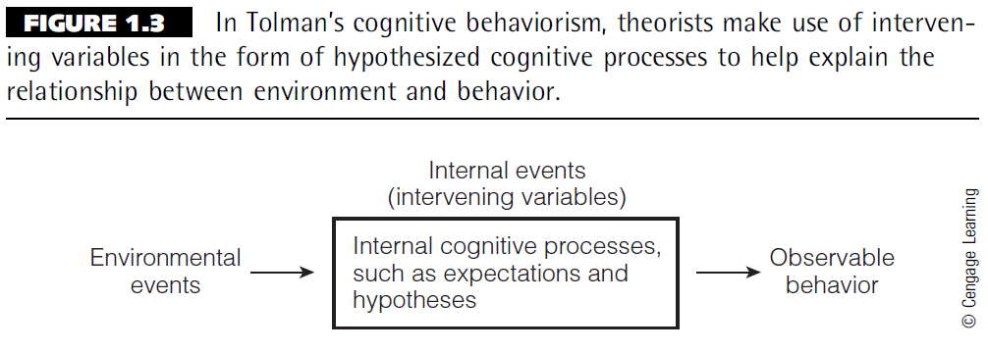
Figure 1.3

Slide 6
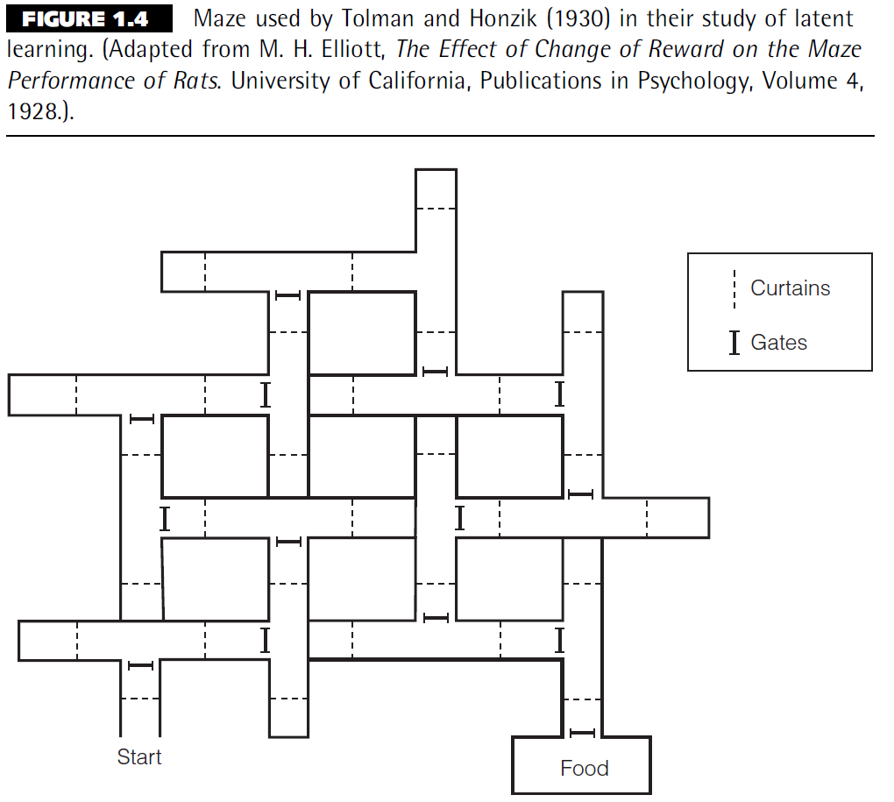
Figure 1.4

Slide 7
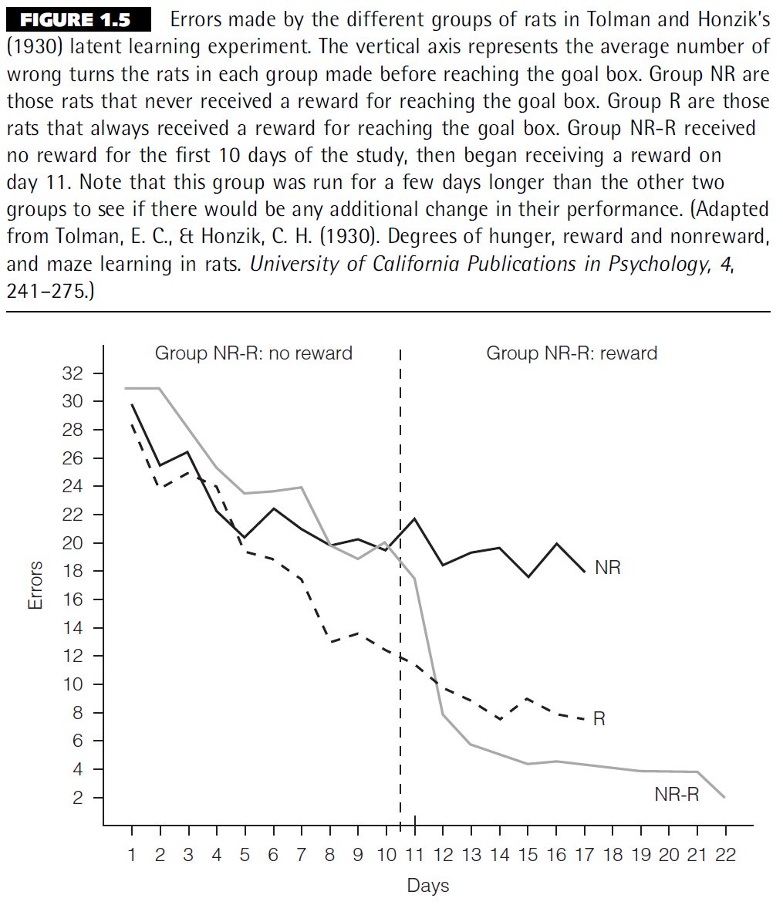
Figure 1.5

Slide 8
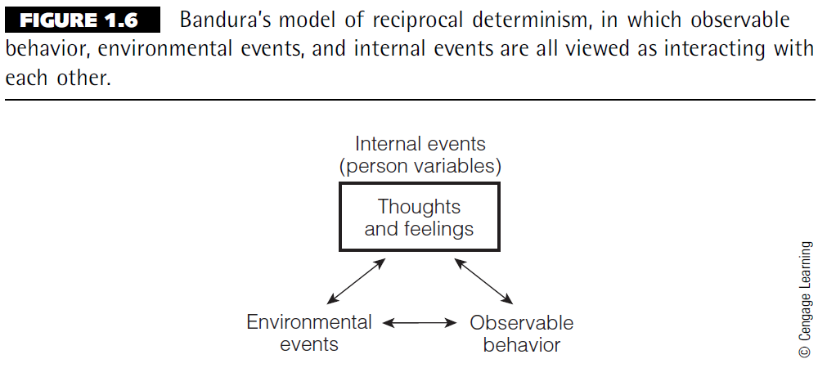
Figure 1.6

Slide 9
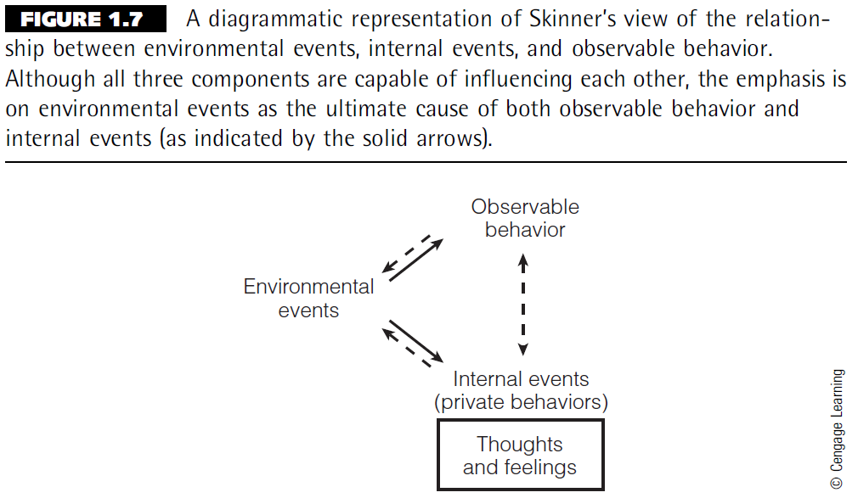
Figure 1.7

Slide 10
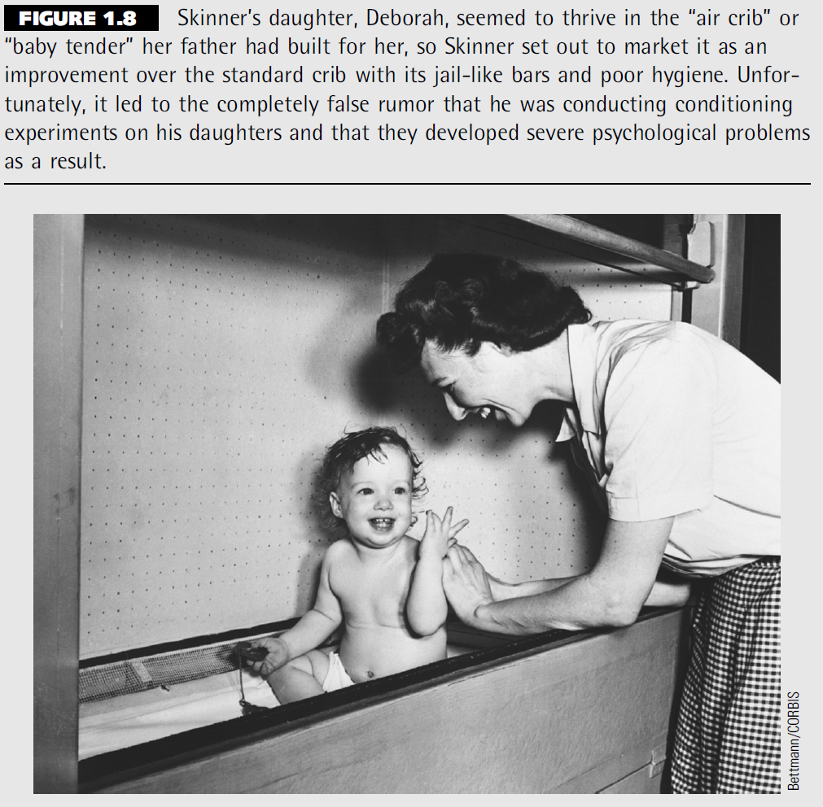
Figure 1.8

Slide 11
Chapter 2

Slide 12
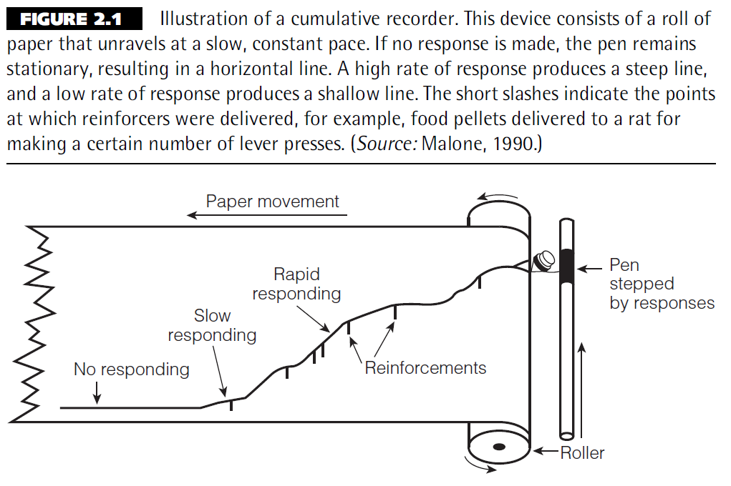
Figure 2.1

Slide 13
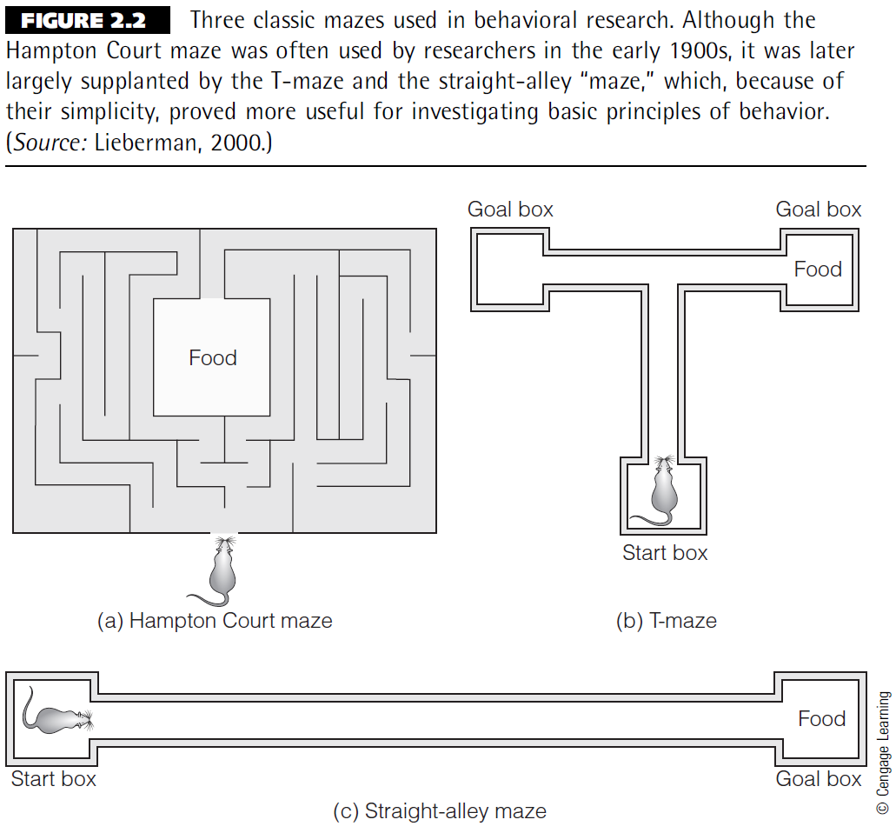
Figure 2.2

Slide 14
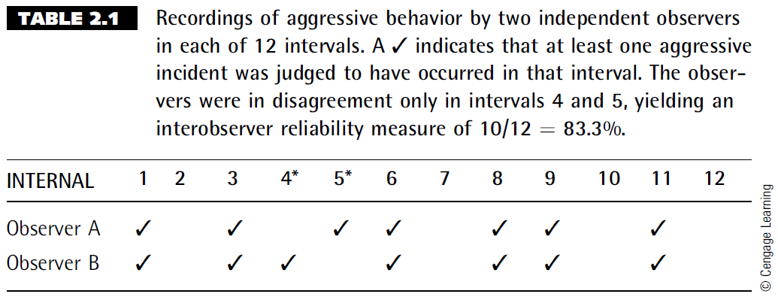
Table 2.1

Slide 15
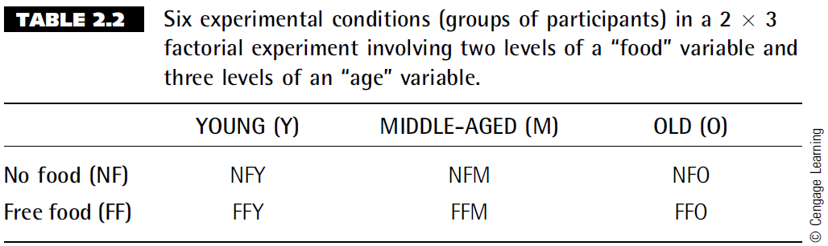
Table 2.2

Slide 16
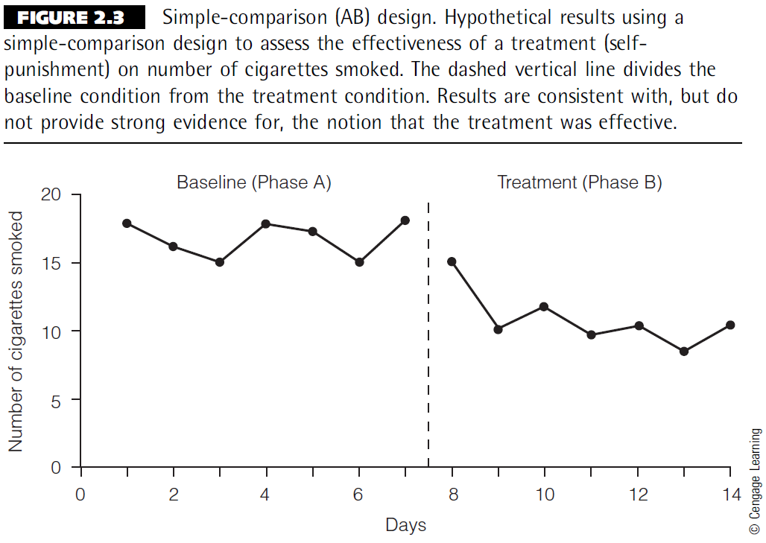
Figure 2.3

Slide 17
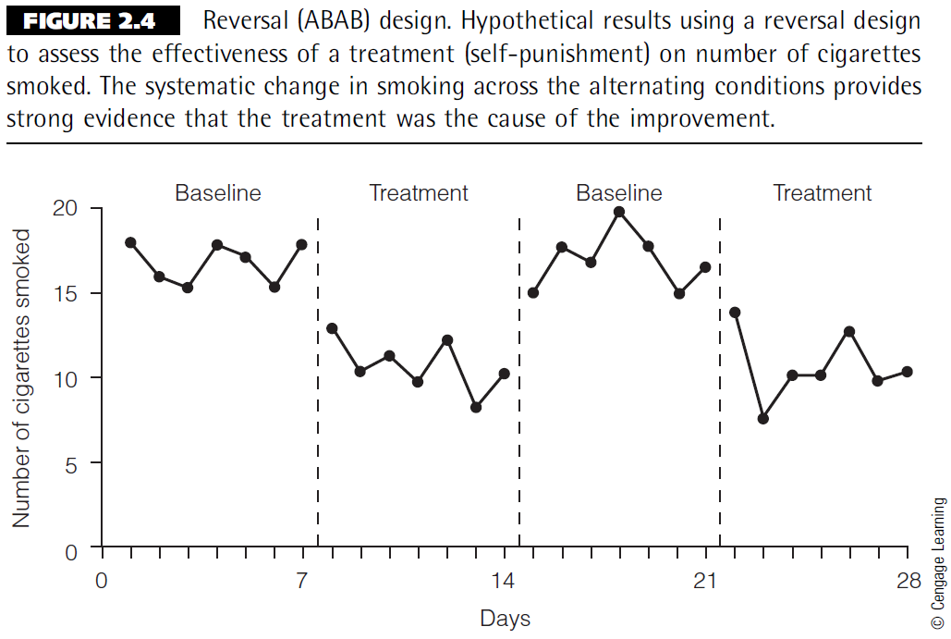
Figure 2.4

Slide 18
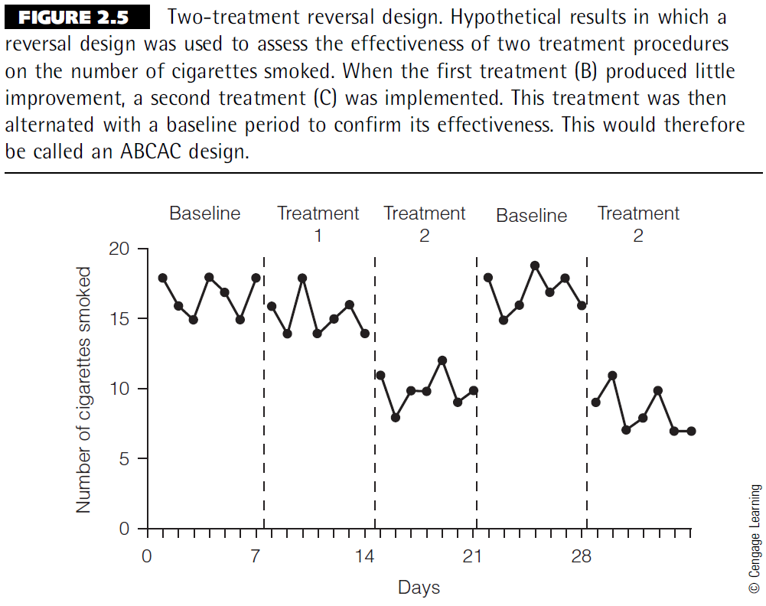
Figure 2.5

Slide 19
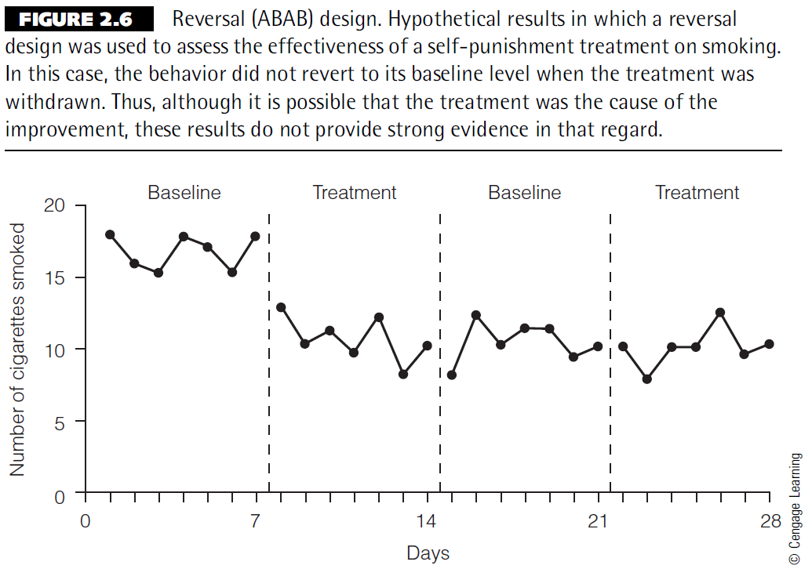
Figure 2.6

Slide 20
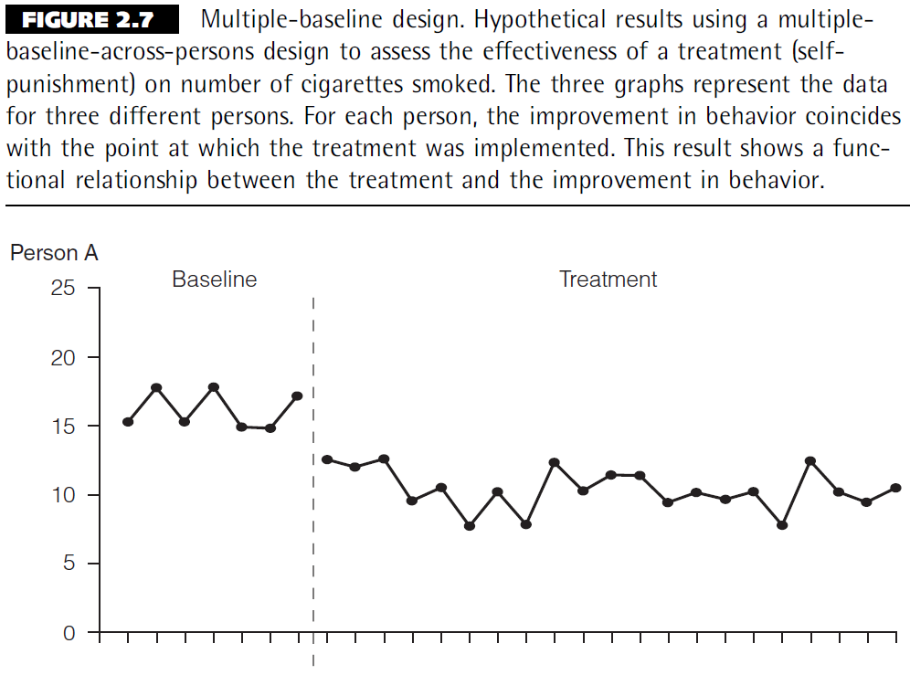
Figure 2.7 (Slide 1 of 3)

Slide 21
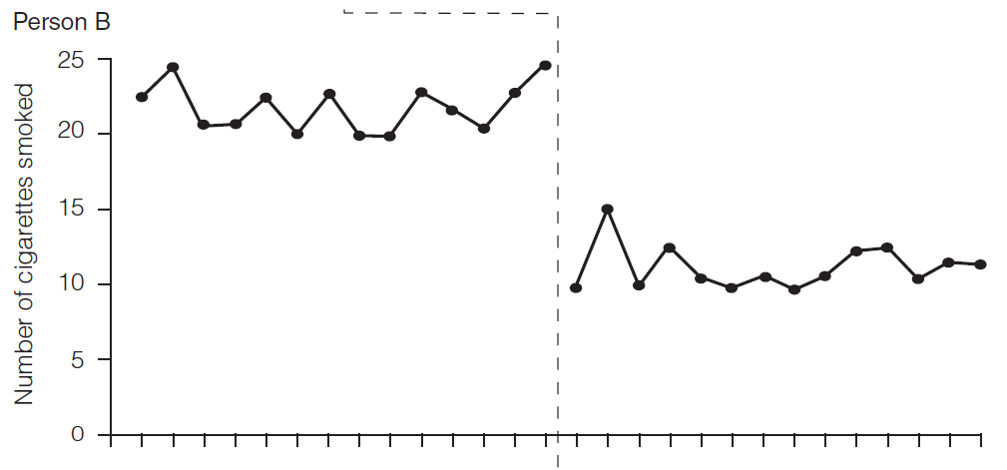
Figure 2.7 (Slide 2 of 3)
Figure 2.7 Continued

Slide 22
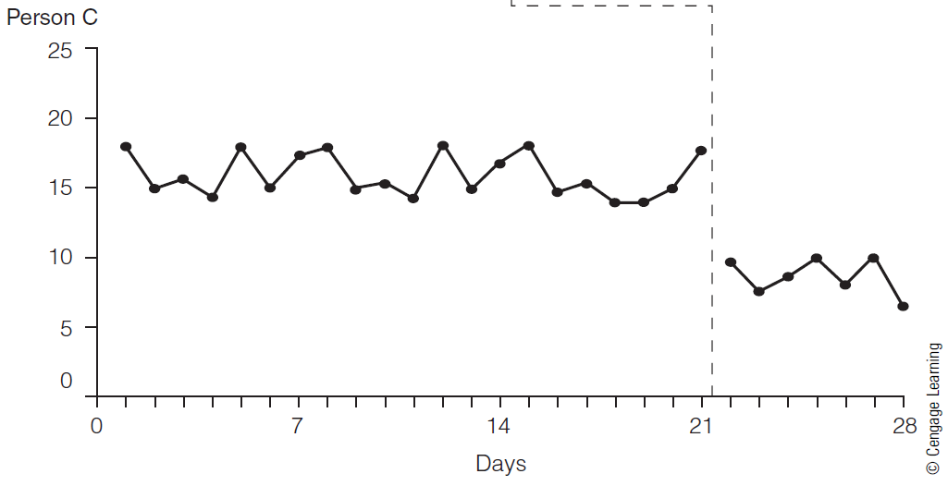
Figure 2.7 (Slide 3 of 3)
Figure 2.7 Continued

Slide 23
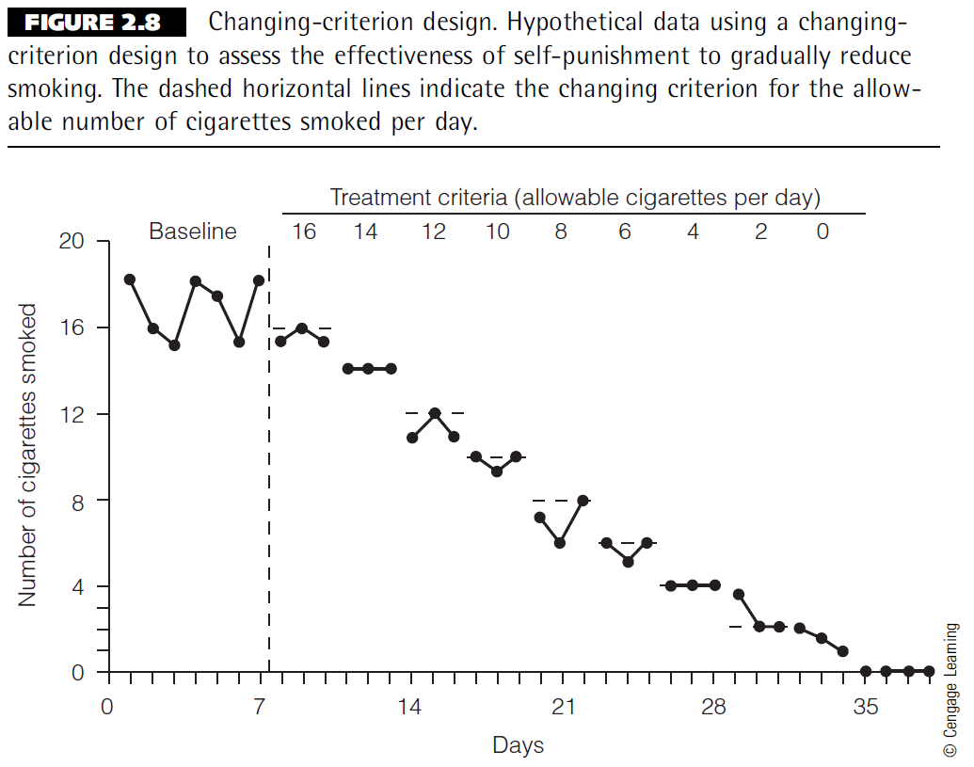
Figure 2.8

Slide 24
Chapter 3

Slide 25
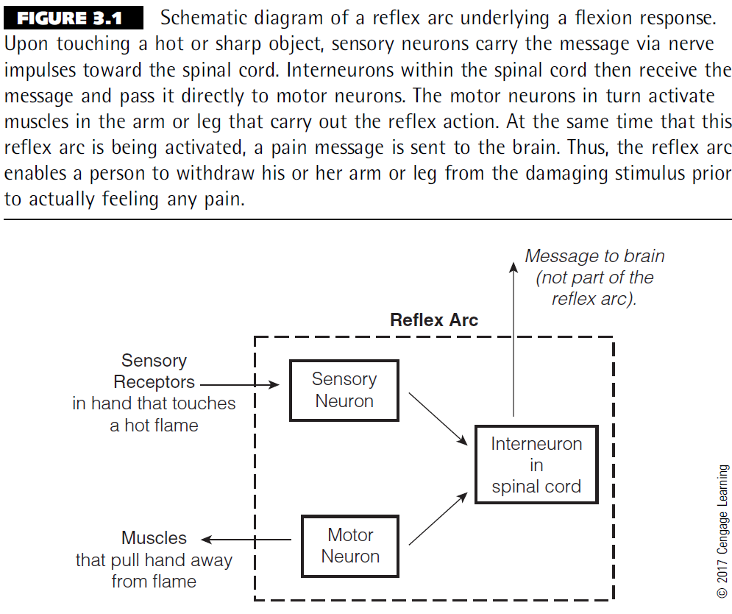
Figure 3.1

Slide 26
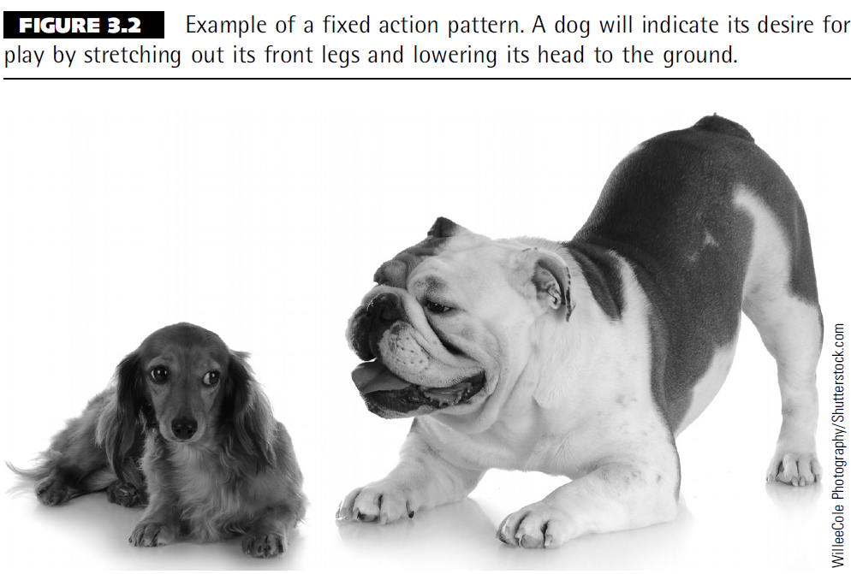
Figure 3.2

Slide 27
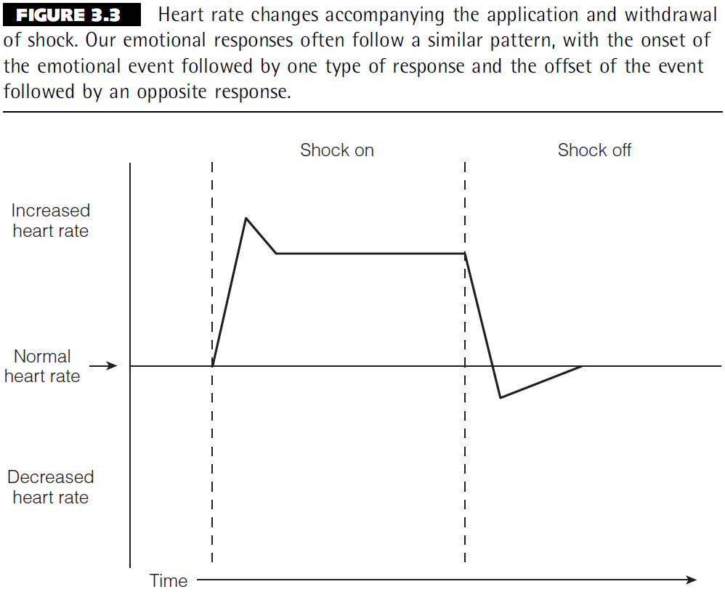
Figure 3.3

Slide 28
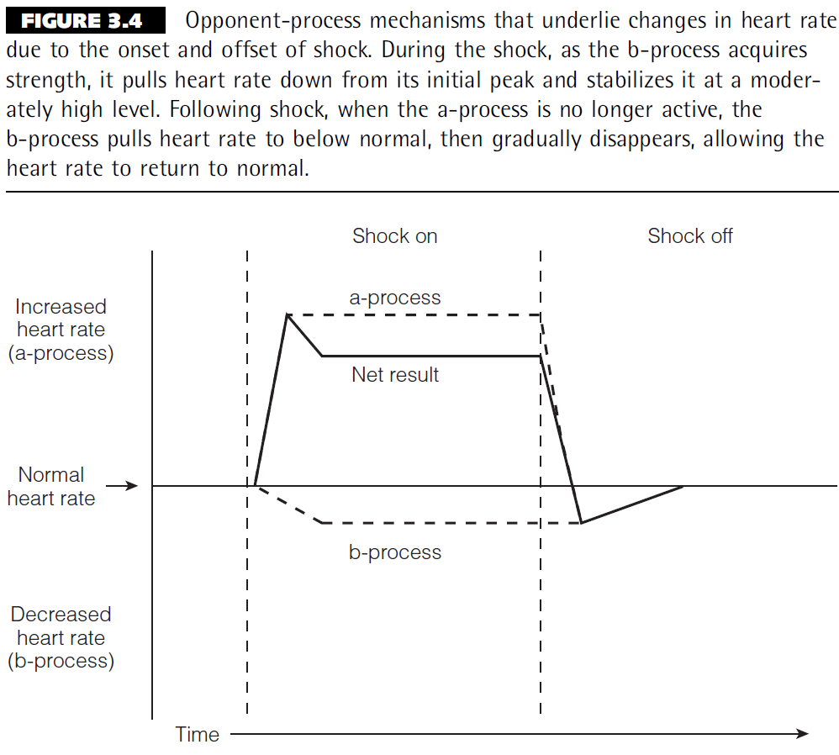
Figure 3.4

Slide 29
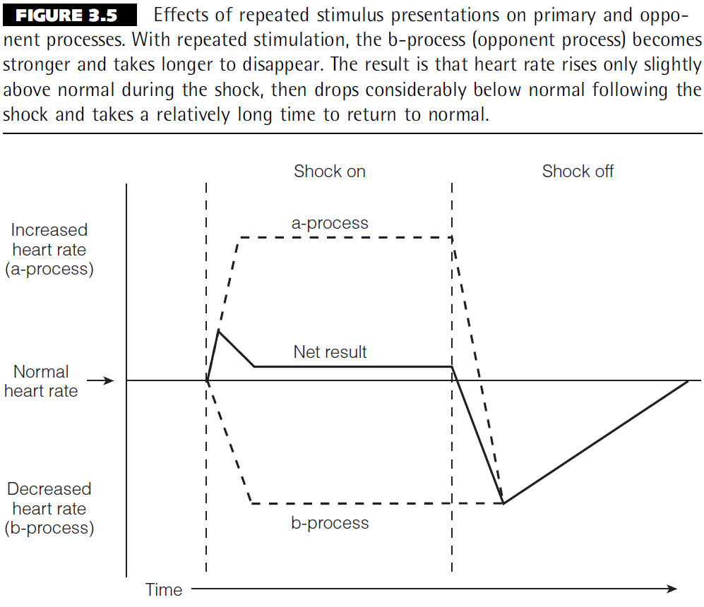
Figure 3.5

Slide 30
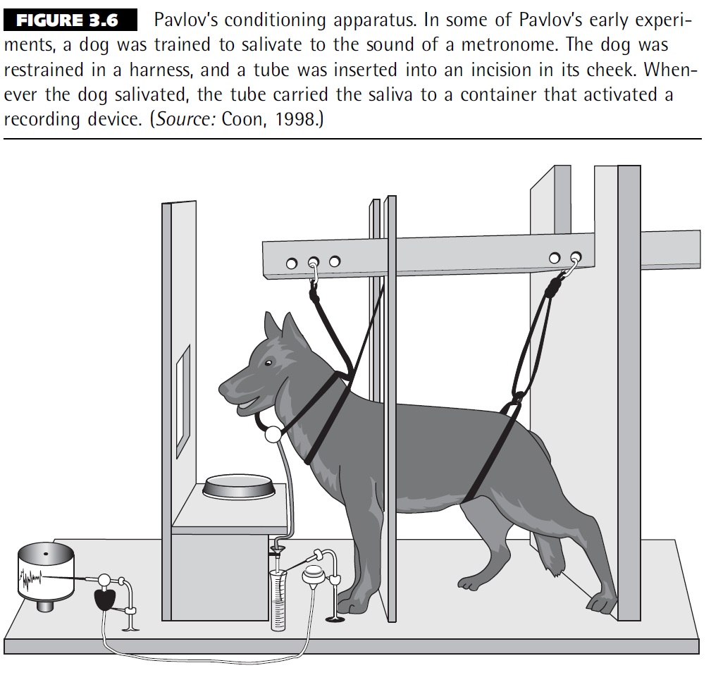
Figure 3.6

Slide 31
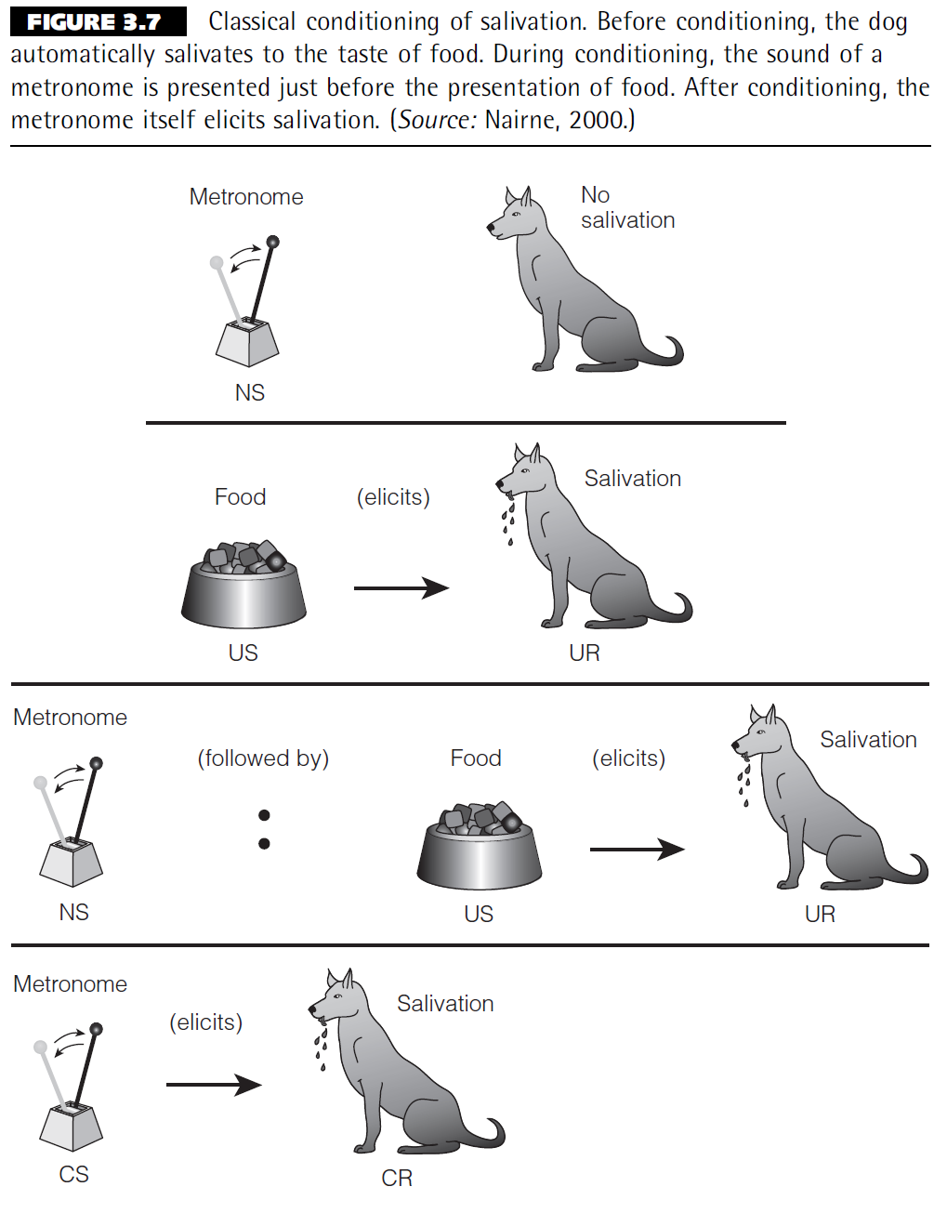
Figure 3.7

Slide 32
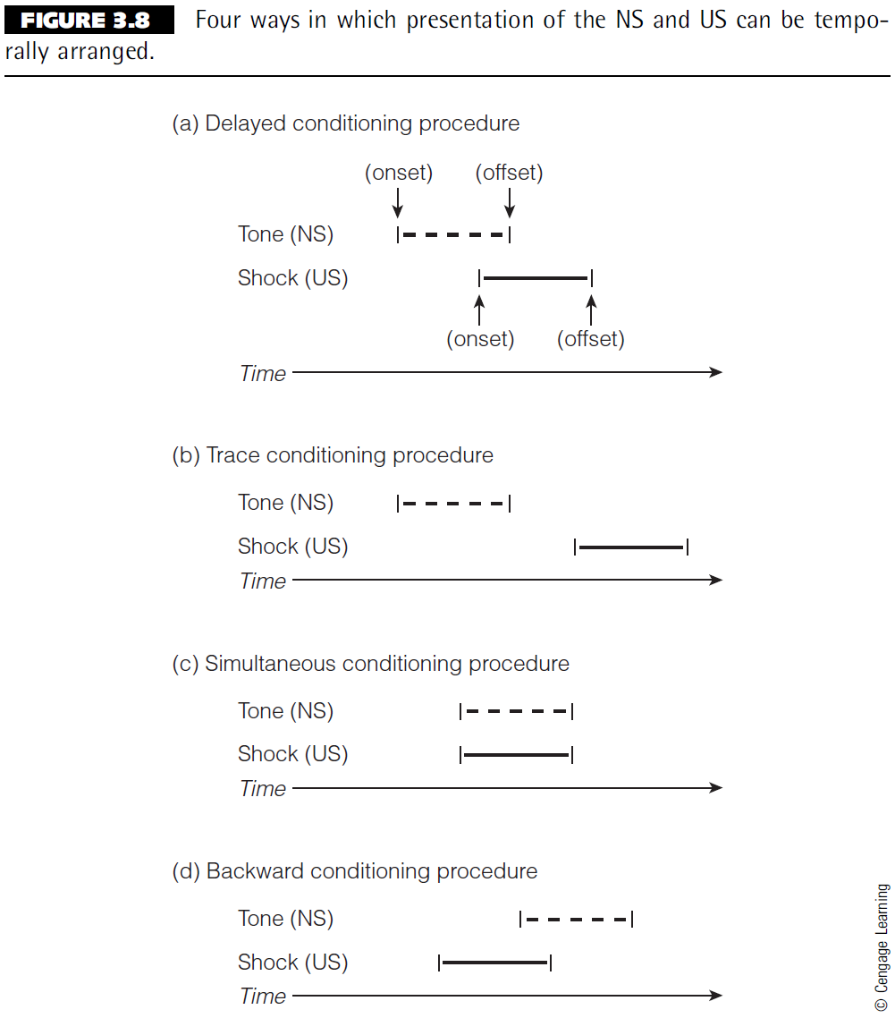
Figure 3.8

Slide 33
Chapter 4

Slide 34
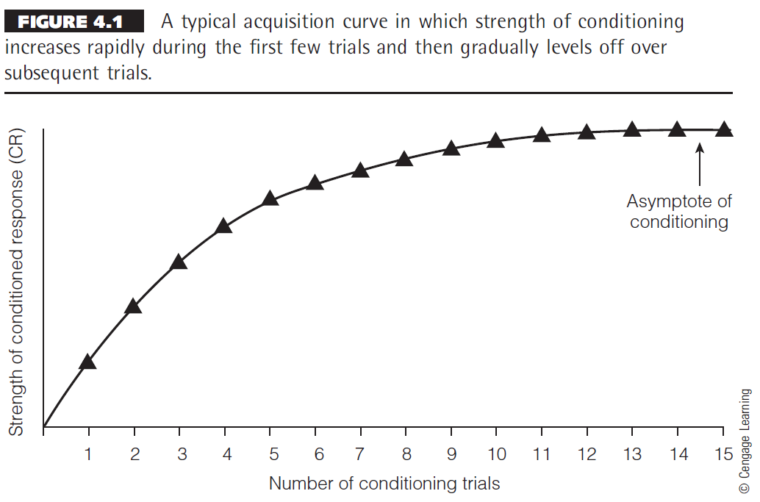
Figure 4.1

Slide 35
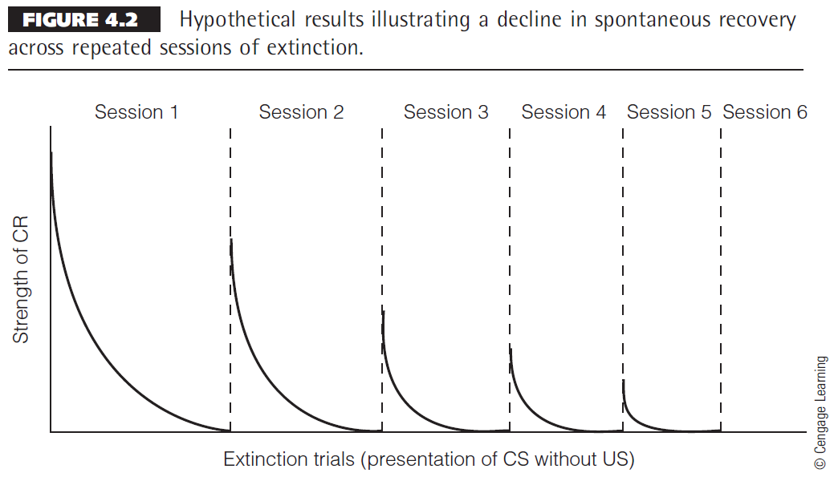
Figure 4.2

Slide 36
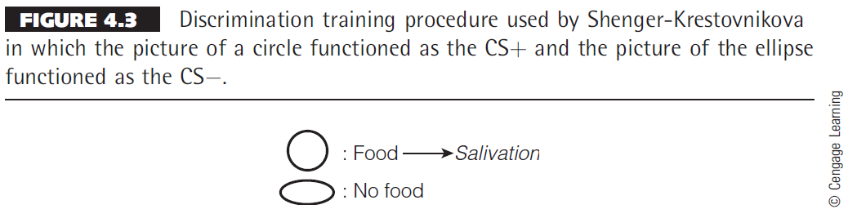
Figure 4.3

Slide 37
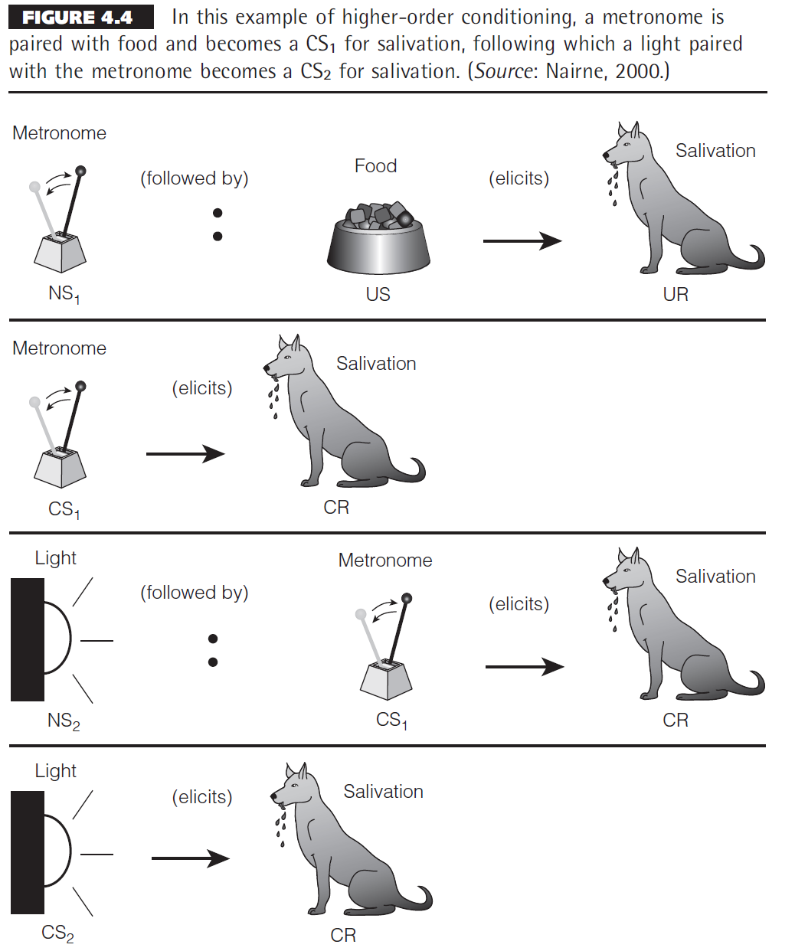
Figure 4.4

Slide 38
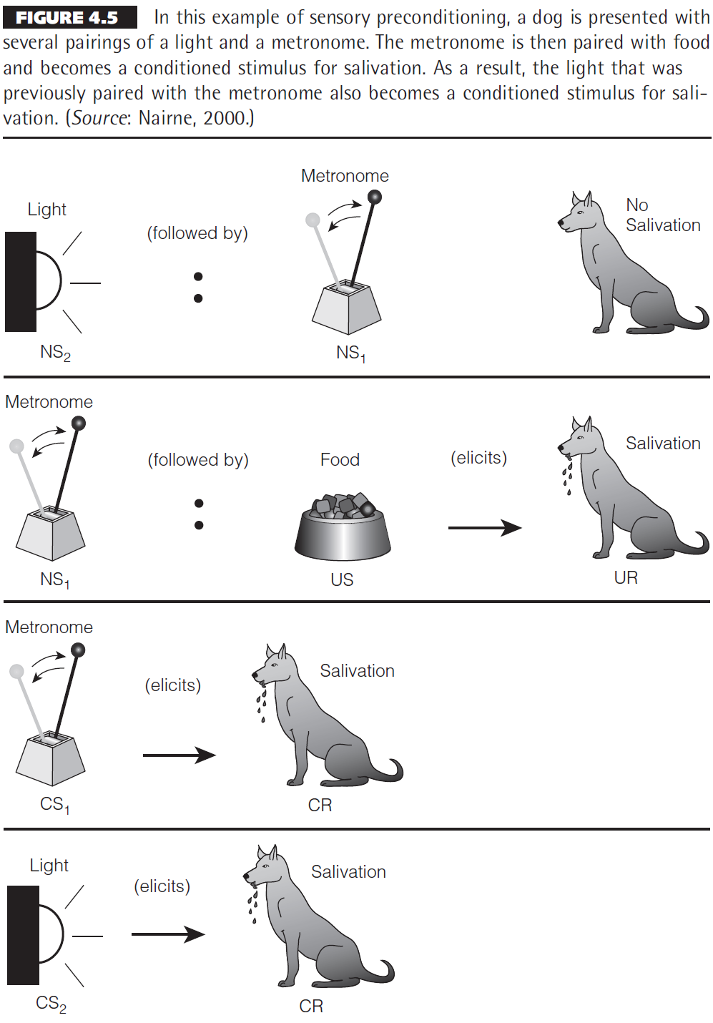
Figure 4.5

Slide 39
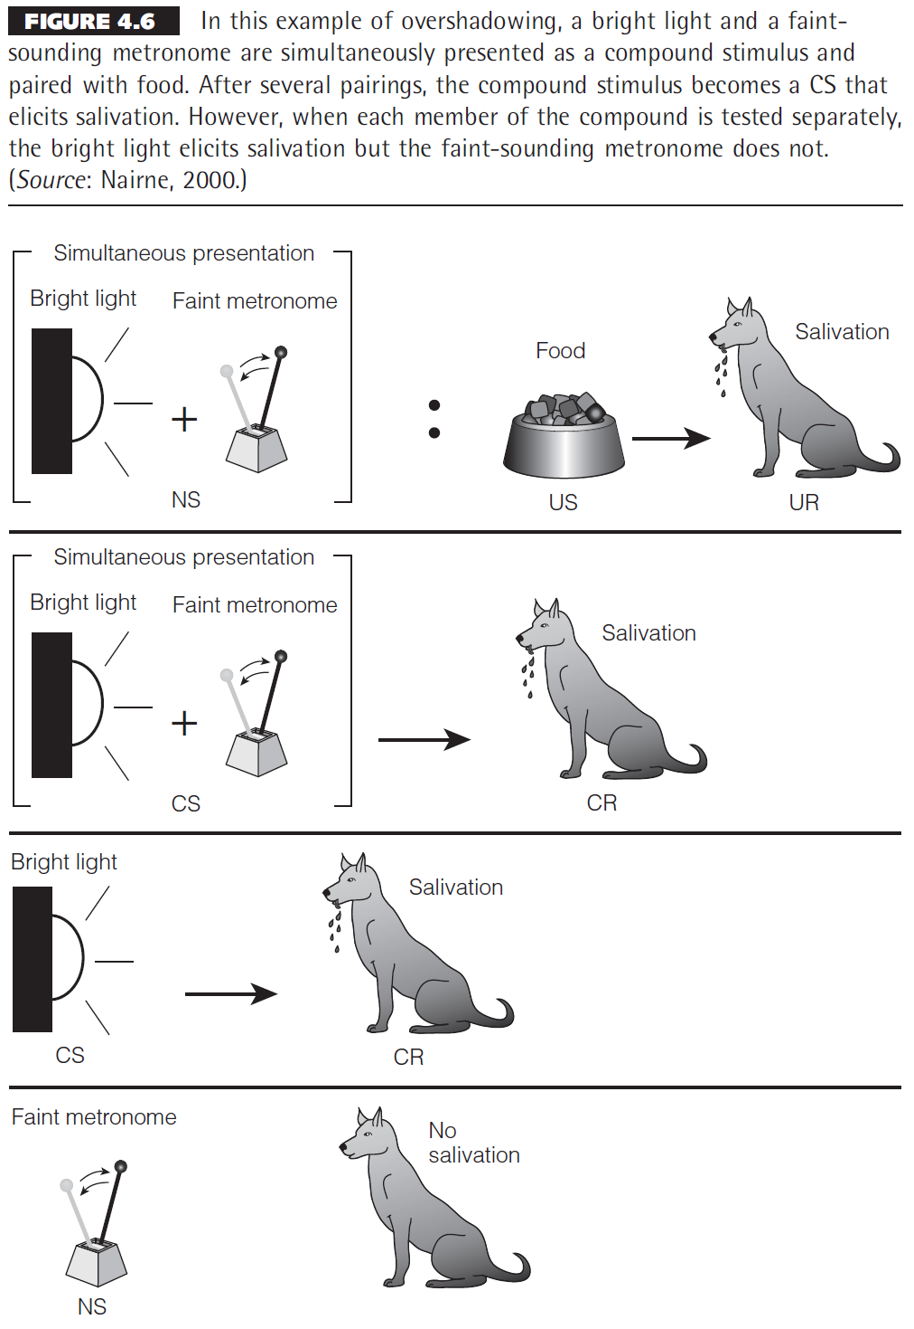
Figure 4.6

Slide 40
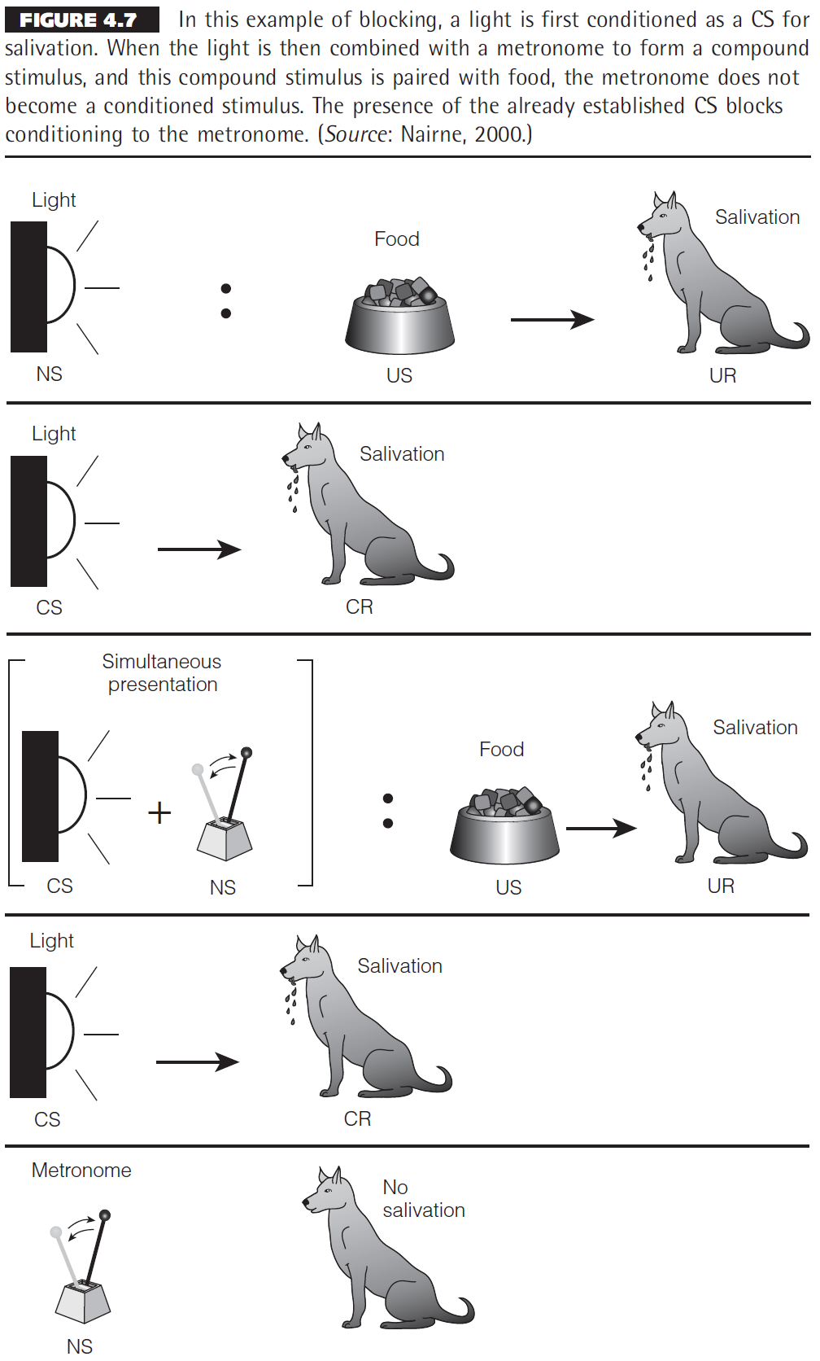
Figure 4.7

Slide 41
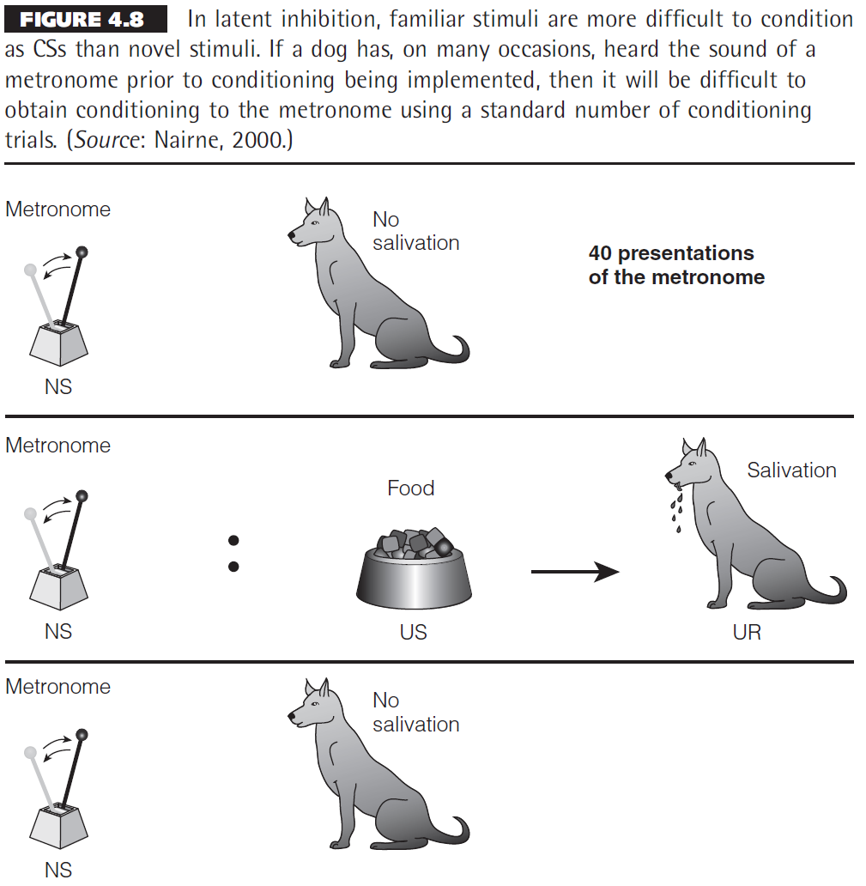
Figure 4.8

Slide 42
Chapter 6

Slide 43
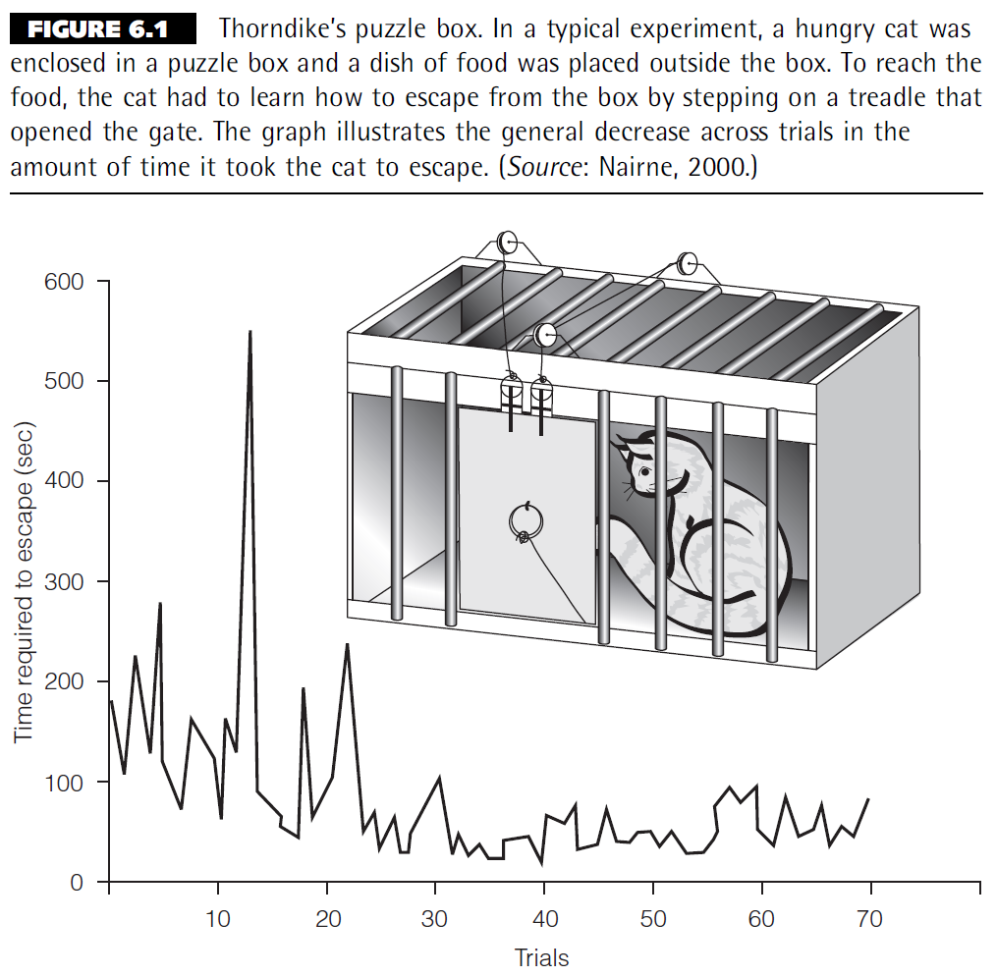
Figure 6.1

Slide 44
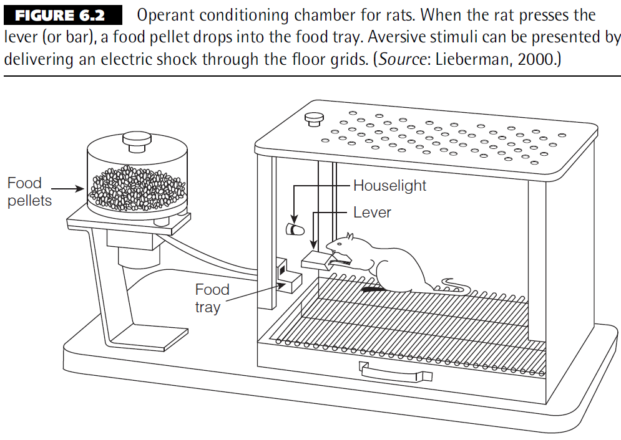
Figure 6.2

Slide 45
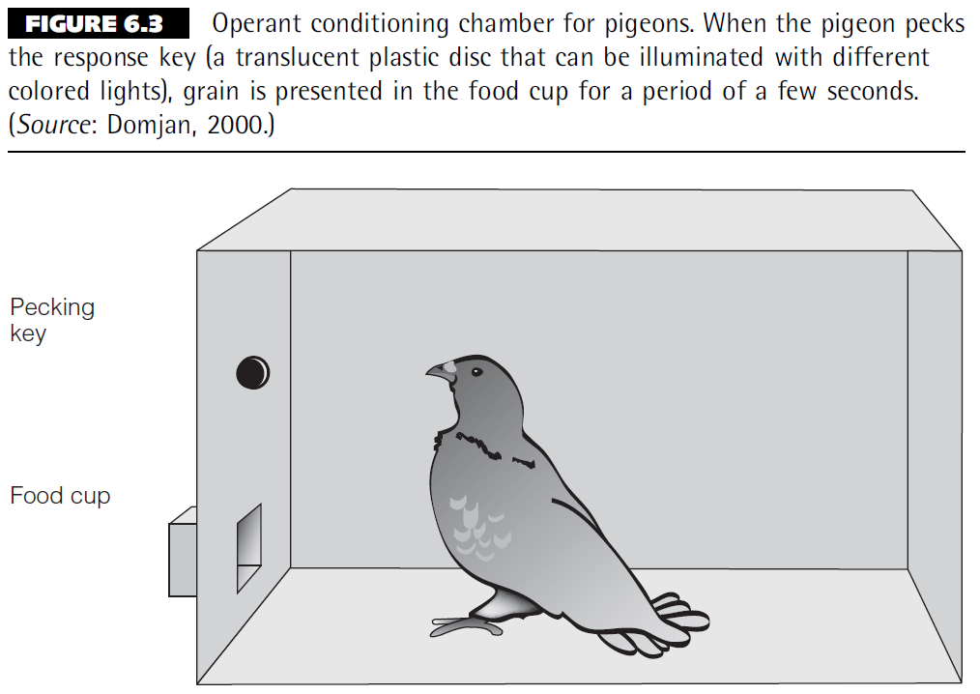
Figure 6.3

Slide 46
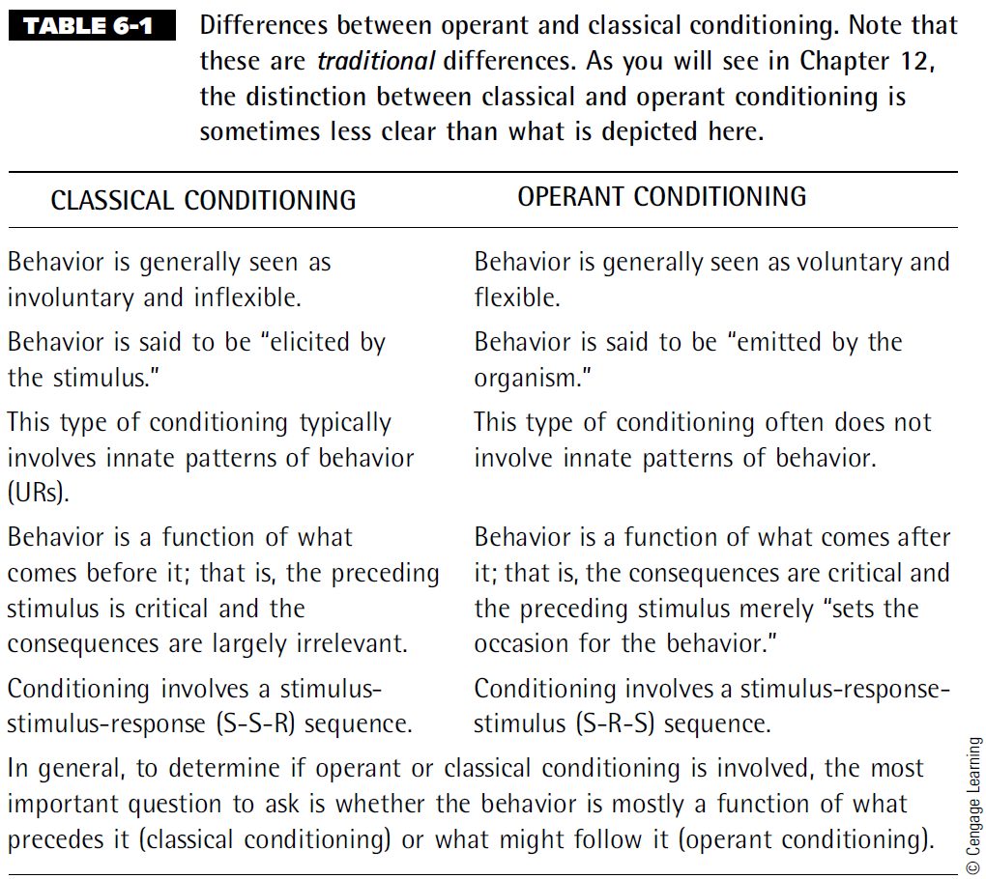
Table 6-1

Slide 47
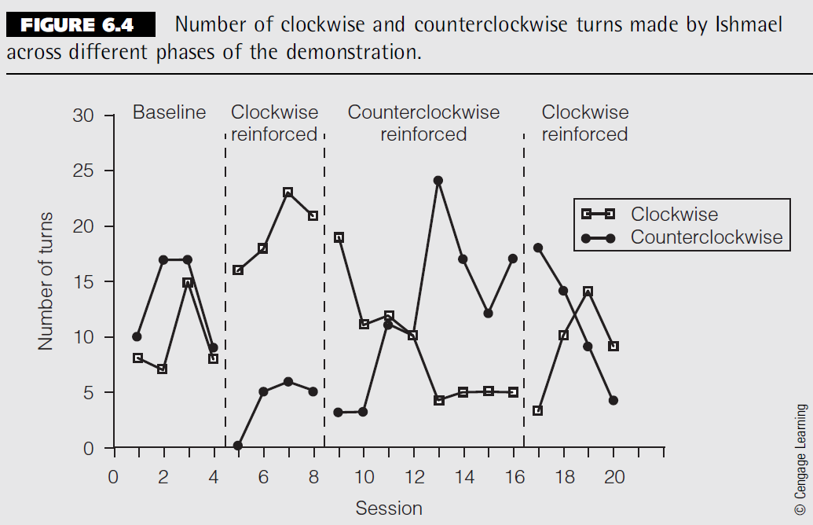
Figure 6.4

Slide 48
Chapter 7

Slide 49
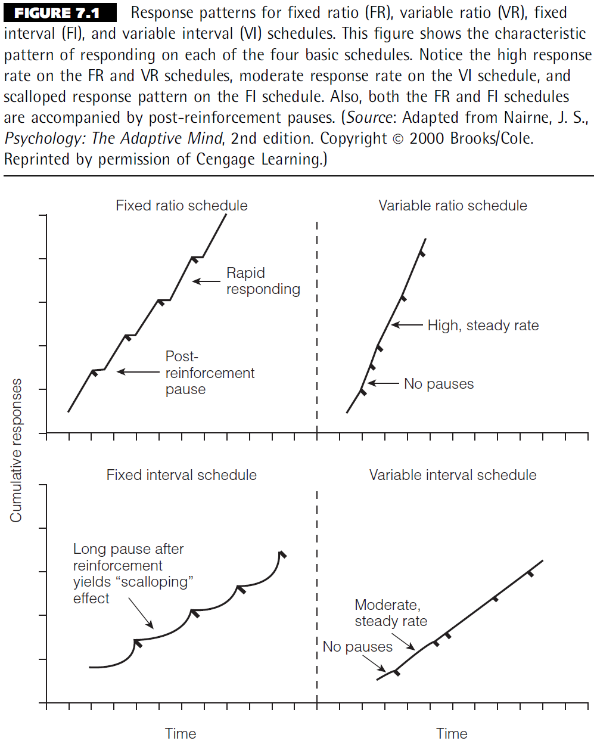
Figure 7.1

Slide 50
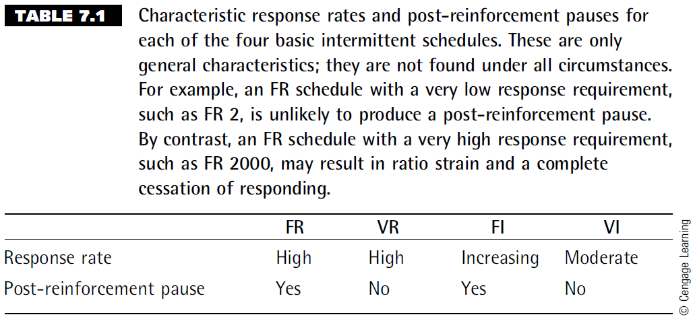
Table 7.1

Slide 51
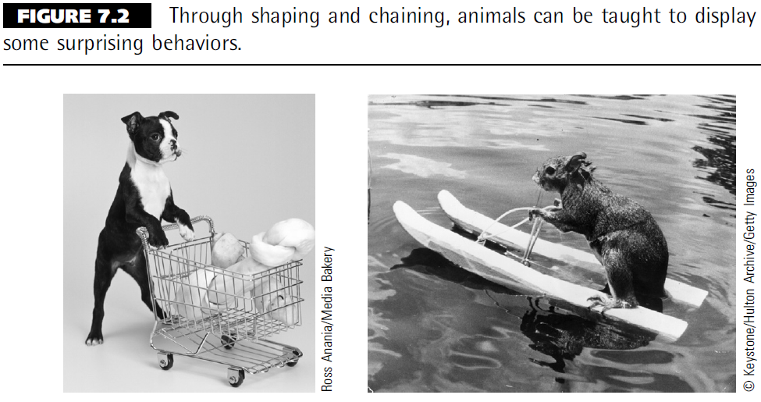
Figure 7.2

Slide 52
Chapter 8

Slide 53
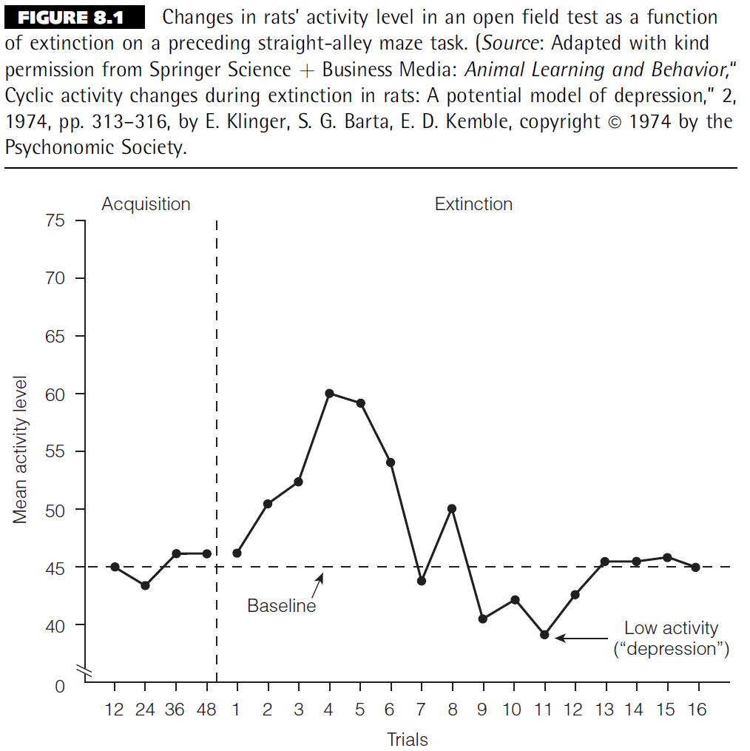
Figure 8.1

Slide 54
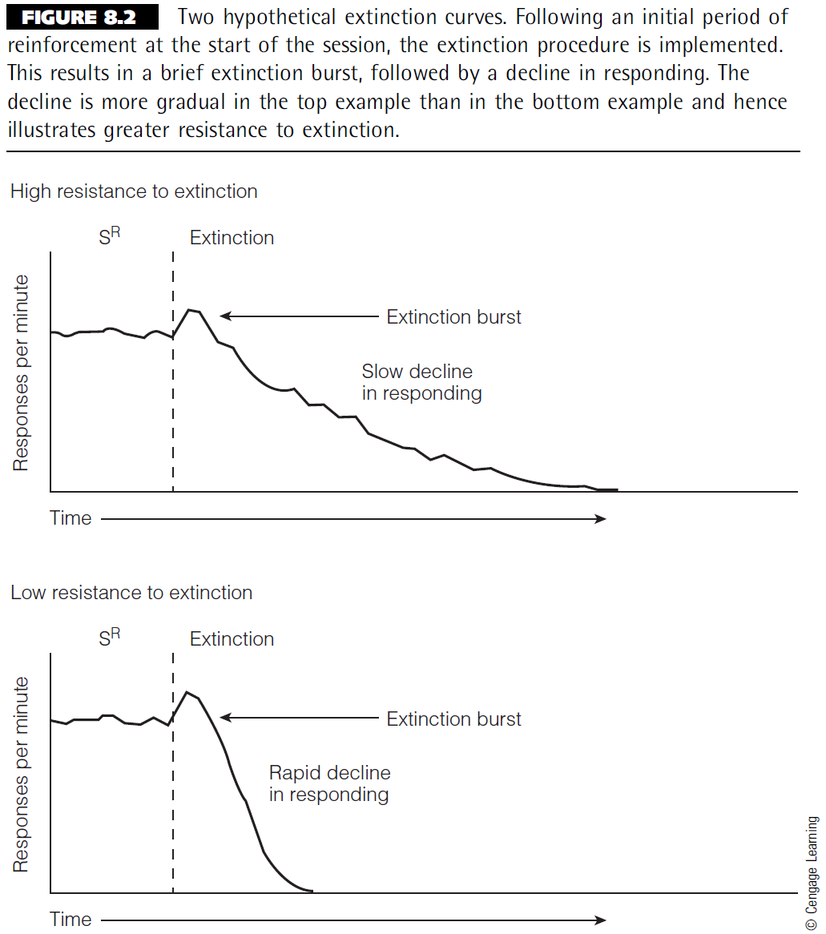
Figure 8.2

Slide 55
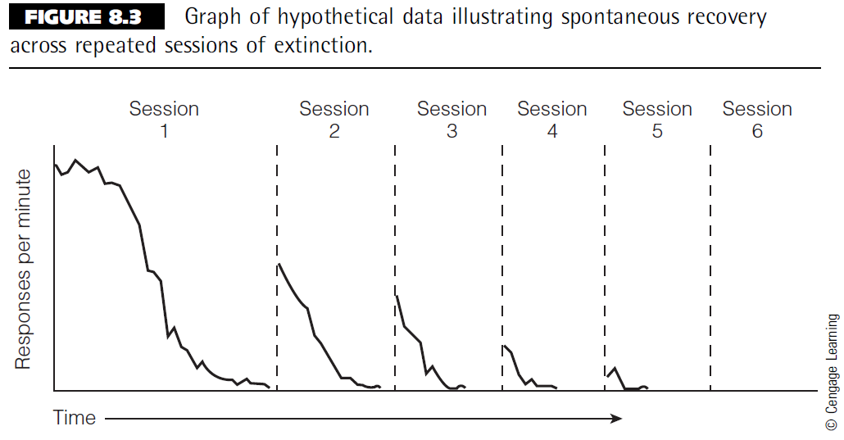
Figure 8.3

Slide 56
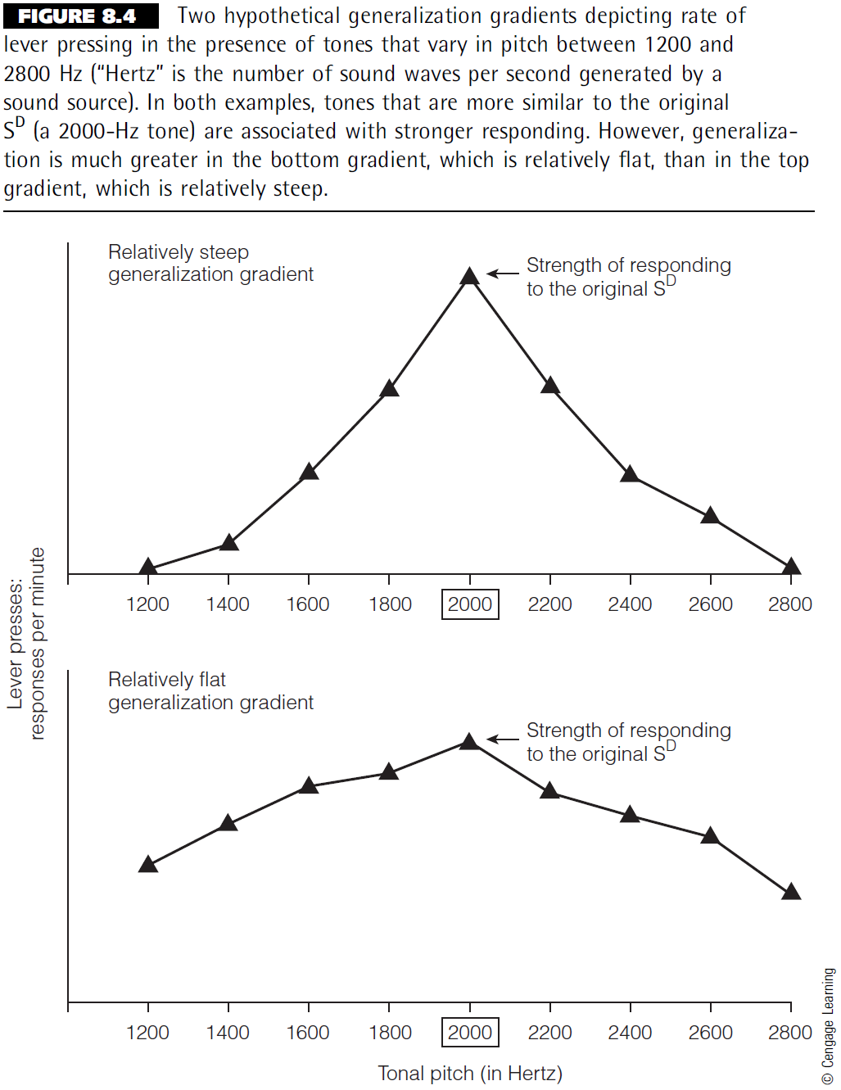
Figure 8.4

Slide 57
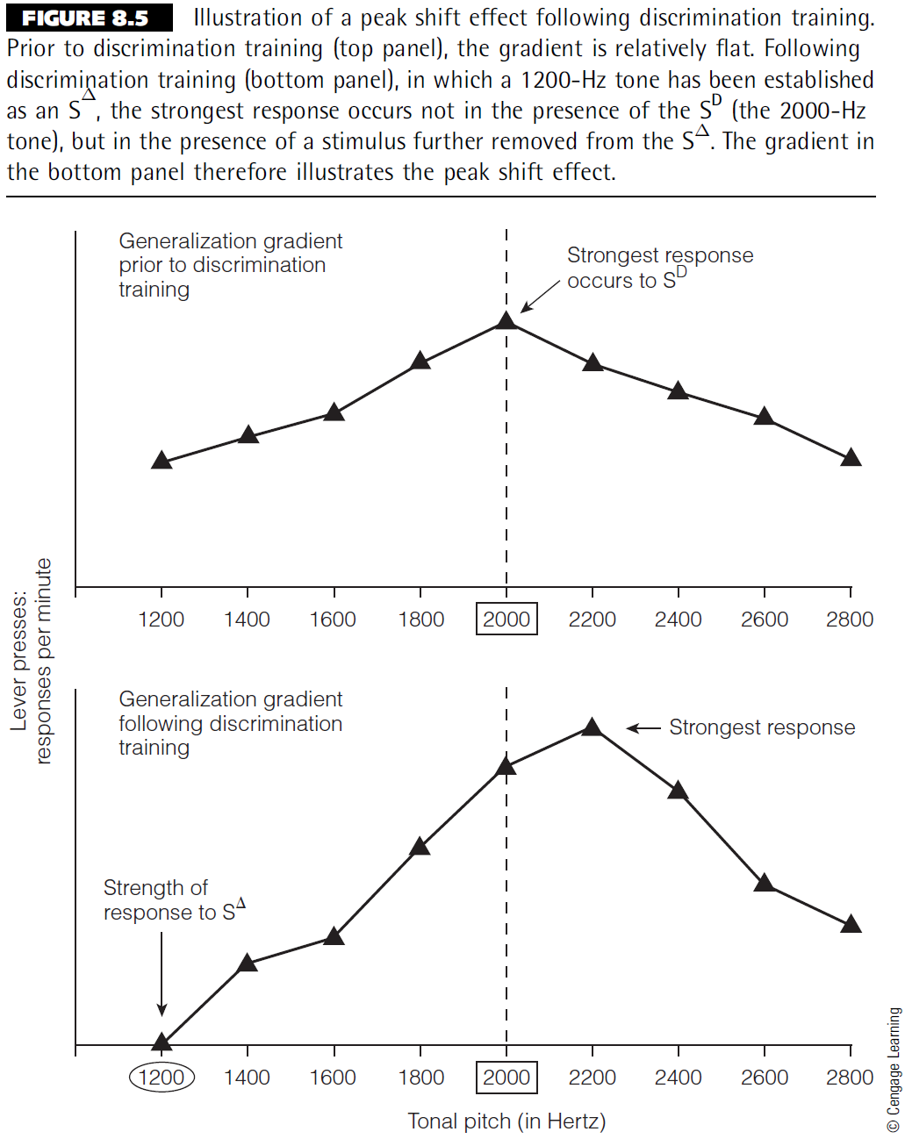
Figure 8.5

Slide 58
Chapter 9

Slide 59
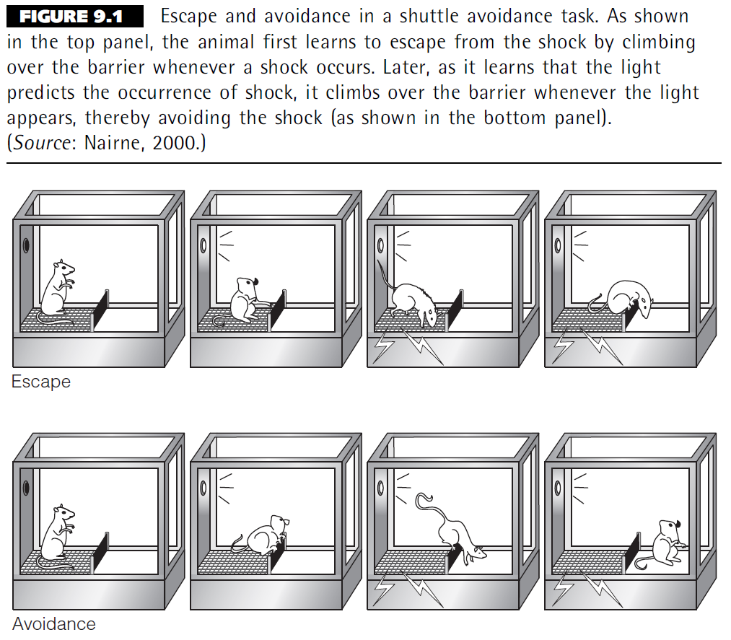
Figure 9.1

Slide 60

Figure 9.2

Slide 61
Chapter 10

Slide 62

Figure 10.1

Slide 63

Figure 10.2

Slide 64

Table 10.1

Slide 65

Table 10.2

Slide 66

Figure 10.3

Slide 67

Figure 10.4

Slide 68

Figure 10.5

Slide 69

Figure 10.6

Slide 70
Chapter 11

Slide 71

Figure 11.1

Slide 72

Figure 11.2

Slide 73
Chapter 12

Slide 74

Figure 12.1

Slide 75

Figure 12.2

Slide 76
Chapter 13

Slide 77

Figure 13.1

Slide 78

Figure 13.2

Slide 79

Figure 13.3

Slide 80

Figure 13.4

Slide 81

Figure 13.5

Slide 82

Figure 13.6

